Slide 1
A Personalized Music Recommendation System
Group Code: 05 Team Members
Mentor: Akhila Madam 1.Aravind Patel [IN30005]
2. Mohit kumar[IN30163]
3. Dileep Chowdary [IN30212]
4. Ajay sai kiran [IN30094]
5. Nitin [IN30063]

Slide 2
Business Problem Statement
Since most of the music albums are sold on digital platform, selecting a particular song from a large database will be a difficult task for an user.
When it comes to providers ,cold start is a big issue as new user does not share any historical data with them.

Slide 3
Business Problem Solution
In order to handle the problem , we have come with a recommender system which uses content based and Content based recommendation system Collaborative Filtering to suggest best suitable song depending upon the user historical data and preferences.
To address this problem we decided to go with content based [use side information such as text, social networks, etc.] from Representative based ,bandit based and Deep learning methods

Slide 4

What Recommendation system is ?
A recommendation engine is a system that suggests products, services, information to users based on analysis of data.
Notwithstanding, the recommendation can derive from a variety of factors such as the history of the user and the behavior of similar users.

Slide 5
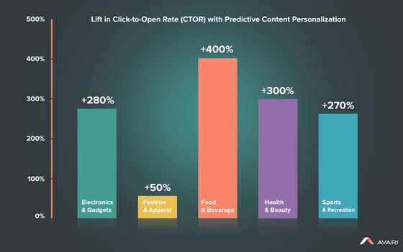
What are the benefits of the Recommendation Engine?
A recommendation engine can significantly boost revenues, Click-Through Rates (CTRs), conversions, and other essential metrics. It can have positive effects on the user experience, thus translating to higher customer satisfaction and retention.
Ref — www.avari.com

Slide 6
Types of techniques for Recommendation systems
There are three main types of techniques for Recommendation systems;
1.Content-based filtering,
2.Collaborative filtering, and
3.Hybrid Recommendation Systems.

Slide 7
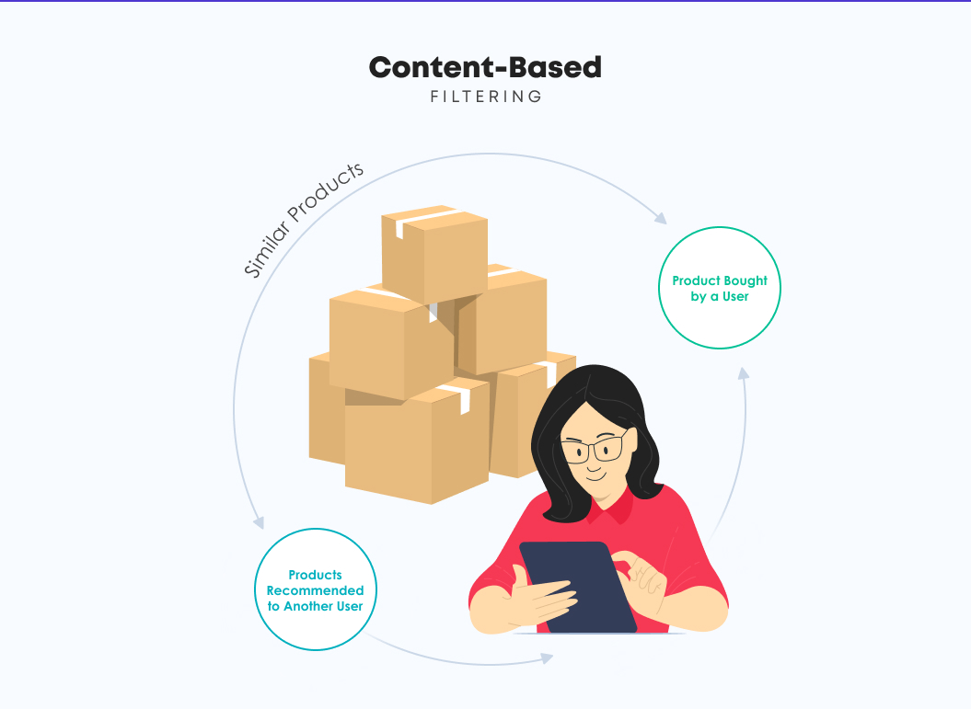
Content-based filtering
Content-based filtering is based on a single user’s interactions and preference. Recommendations are based on the metadata collected from a user’s history and interactions.

Slide 8
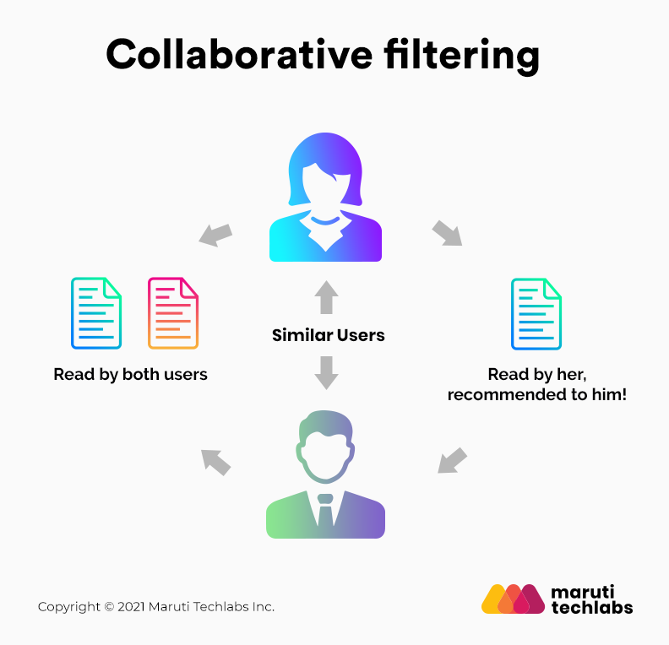
Collaborative filtering
The collaborative filtering method is based on collecting and analyzing information based on behaviors, activities, or user preferences and predicting what they will like based on the similarity with other users.
The prediction is done using various predictive maintenance machine learning techniques.
User-User collaborative filtering
Item-Item collaborative filtering

Slide 9
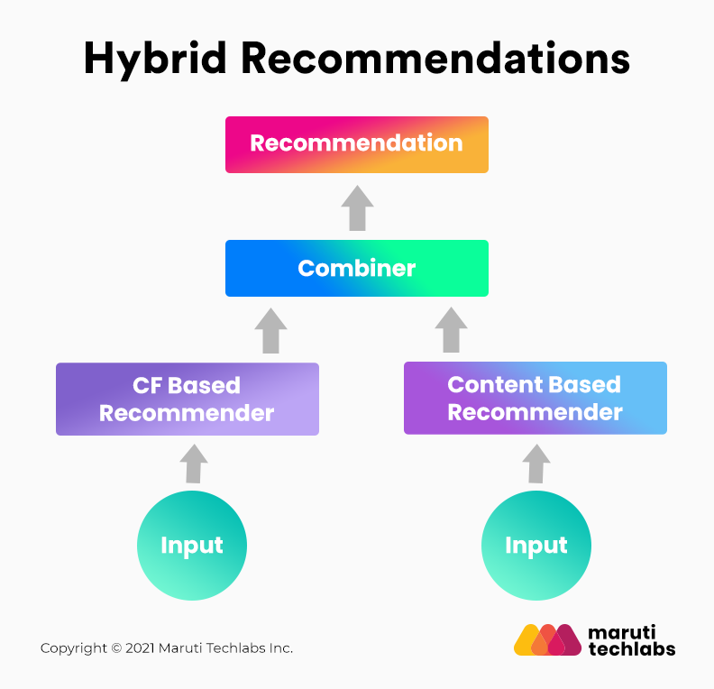
Hybrid Recommendation Systems
Hybrid Recommendation engines are essentially the combination of diverse rating and sorting algorithms. For instance, a hybrid recommendation engine could use collaborative filtering and product-based filtering in tandem to recommend a broader range of products to customers with accurate precision.

Slide 10
Cold Start Problem
If you don’t have knowledge of your users, you can’t personalize them. And having no personalization is a huge issue because you want to make new visitors feel welcome so they’ll become loyal returning customers.
Repeat customers are ideal and you’ll want to keep them happy, but there’s nothing like adding a new one to the list.

Slide 11
This problem is so big that it has a name—it’s called cold start. It’s a term used not only for serving recommendations to new users, but also for introducing new items into your catalog.
New items won’t show up in any of the non-personalized recommendations because they don’t have the numbers to enter into sales statistics, and they won’t appear in personalized recommendations because the system doesn’t know how to relate those to other items.

Slide 12
Gray sheep
A user who has such an individual taste that even if there’s data, there are likely no other consumers—or very, very few people—who’ve bought any of the products the gray sheep has.
The reason it’s here among the cold-start problem is that gray sheep create the same issue of calculating recommendations for users that you don’t have any data on. And certain solutions overlap between cold visitors and gray sheep

Slide 13
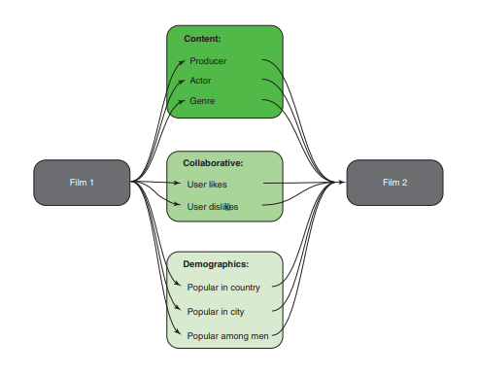

Slide 14
Data Kinds that recommender utilizes
User Behavior Data:
Users behavior data is useful information about the engagement of the user on the product. It can be collected from ratings, clicks and purchase history.
User Demographic Data:
User demographic information is related to the user’s personal information such as age, education, income and location.
Product Attribute Data:
Product attribute data is information related to the product itself such as genre in case of books, cast in case of movies, cuisine in case of food.

Slide 15
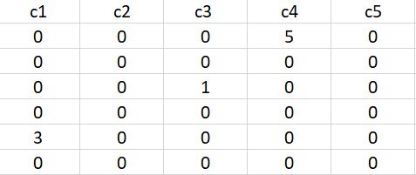

What are the common challenges a Recommender System face?
Sparsity of data.
Data sets filled with rows and rows of values that contain blanks or zero values. So finding ways to use denser parts of the data set and those with information is critical.
Latent association.
Labelling is imperfect. Same products with different labelling can be ignored or incorrectly consumed, meaning that the information does not get incorporated correctly.
Scalability.
The traditional approach has become overwhelmed by the multiplicity of products and clients. This becomes a challenge as data sets widen and can lead to performance reduction.

Slide 16
HOW DO WE PROVIDE DATA FOR RECOMMENDER SYSTEMS?
Explicit Ratings
Implicit Ratings
Product Similarity (Item-Item Filtering)
User Similarity (User-User Filtering)

Slide 17
How do you measure your Recommendation System?
Conventional measurement techniques include measures of accuracy or coverage measures.
Accuracy
It can be described as the fraction of correct recommendations out of the total possible recommendations
Coverage measures
The number of items or users that the system is actually able to provide recommendation for.

Slide 18
Methodology we are going to implement
Content Based filtering | Collaborative filtering
Term frequency–inverse document frequency | Item-based

Slide 19
Conclusion
By the end of this project we will be able to develop an efficient personalized recommendation system using content and collaborative recommendation systems.

Slide 20
Project Timeline
Mid Project Presentation 1: 10th June, 2021
Exploratory Data Analysis
Mid Project Presentation 2: 14th June, 2021
PPT for EDA Conclusions
Jupyter File with code implementation of EDA
Data Preparation

Slide 21
Popularity Based Recommendation System Implementation
Collaborative Filtering Based Recommendation System Implementation
Content Based Recommendation System Implementation
Mid Project Presentation 3: 21st June, 2021
Final Improvements
Future Scope
Final Presentation: 26th June, 2021

Slide 22
Project Status
EDA in Progress

